Slide 1


Annual Train the Trainer 2026-2027
Jennifer Kent, MEA Benefits Trust, Executive Director
Sharon Beaulieu, MEA Benefits Trust, Benefits Manager
Lynn Aceto, MEA Benefits Trust, Field Account Manager
Patty Whitcomb, Anthem BC/BS, Account Specialist

Slide 2
Agenda
Introductions Jennifer Kent, Sharon Beaulieu, Lynn Aceto, and Patty Whitcomb
July 1, 2026, Renewal & Benefit Changes/Enhancements
Open Enrollment Process Reminder & District Responsibility (90-day notification)
COBRA quick overview, +26 and others
Rehiring Retirees-Statute and Guidance
Employer Access-Important Dates, Reminders & Assistance information
Programs and Services available

Slide 3
What does the MEA Benefits Trust Do?
The MEA Benefits Trust manages your medical, pharmacy and vision plans as well as the wellness program
We are not the MEA nor are we Anthem
We are responsible for representing all our members:
  Negotiating the insurance plans with the carrier to ensure we are offering the highest level of benefits at the most appropriate price
  Responsible for benefit changes within the plans and new program offerings
  Support the school district business offices with eligibility, rating and benefit questions
  Attend meetings to educate and promote the plans
  Educate and promote the Personify Health wellbeing program
  Support members with complex benefit and/or retirement inquiries

Slide 4

Check out our website: www.meabt.org
RETIREMENT

Slide 5
Renewal July 1, 2026 – June 30, 2027
Medical and pharmacy cost trends continue to be the primary drivers of health insurance renewals.
The Trust implemented targeted plan benefit changes to offset a portion of the required premium increase.
The Trust again used saving achieved in prior years from reduced claims experience to further reduce the underlying increase to an average of 7.5%
For the July 1, 2026, plan year, the Board of Trustees voted to set:
  Minimum rate increase: 3.0%
  Maximum rate increase: 11.5%
  Community Rate: 7.5%
Rate increase emails were sent to all districts on Friday, March 27th

Slide 6
July 1, 2026 Plan Benefit Changes
MEA Choice Plus, MEA Choice Plus Value Plan & All MEA Standard Plans
  No visit limit for chiropractic physical manipulations
  Total out-of-pocket cost limit will increase from $9,200 to $10,600 per member
  The Emergency Room benefit will change from a $300 copayment to coverage with coinsurance after you meet your deductible.
  SmartShopper: A new savings and rewards program which allows members to compare care locations in their plan’s network for over 100 medical procedures and tests.
    If the member chooses a high-value, reward-eligible location for care, SmartShopper will send the member a cash reward. Rewards vary by procedure and are between $25 - $1,000.

Slide 7

SmartShopper

Slide 8
Open Enrollment & the Distribution of
Important Plan Documents
Please provide Open Enrollment information to ALL your benefit eligible employees; not just to employees making a change to their benefits.
  Your “Healthcare that Connects with You” Booklet, discover benefits that support your well-being
Distribution of Important Plan Documents – DOL Requirement
  Summary Plan Description Certificates of Coverage
  Summary of Benefits and Coverage
  Link to the new MEABT website to find Important Plan Documents (www.MEABT.org)
  Instruction on how to obtain paper copies of all documents
MEABT will send a pre-developed email with all the required information to the districts that can be forwarded to all employees.

Slide 9
Open Enrollment Important Dates & Information
During the month of May: Anthem and the MEABT will have communicated rate and benefit changes to all MEA plan participants (Active, Retired, COBRA) through the annual newsletter mailing. Districts will have received their Open Enrollment posters and booklets.
Open Enrollment, this year it is from May 1 - May 29.
July 1st: Effective date of rate & benefit changes for everyone.
July 1st, August 1st, or September 1st: Based on the member’s bargaining contract, these are the dates additions, deletions or plan changes employees make during the Annual Enrollment period will become effective.
Paper Applications: (Please include the complete group number on applications, this is NOT the 008999 number) The full group number will look like: 008120001B. Mail applications to Anthem BC/BS, 2 Gannett Dr., S. Portland, ME 04106 or email:
ME-Employer@Anthem.com Anthem will not accept applications any earlier than 60 days from the requested effective date.
The date chart below will ensure that your employee receives their ID card by their effective date.
For July 1 effective date, paper apps should be received by 6/1,
For August 1 effective date, paper apps should be received by 7/1,
For September 1 effective date, paper apps should be received by 8/1
Employer Access:
If the employee’s Open Enrollment effective date is July 1, it can be processed in Employer Access, May 1 – June 30.
If the employee’s Open Enrollment effective date is August 1, it can be processed in Employer Access July 1 – July 16.
If the employee’s Open Enrollment effective date is September 1, it can be processed in Employer Access July 17- September 15.
Notes:
Please print this out for your convenience

Slide 10
Other Important Dates & Information
Effective Dates for New Hires
Regular New Hire through Employer Access is the 1st of the month following the Date of hire. If your district has a longer waiting period you must notify Anthem, so your enrollments can process correctly in the system.
If your DOH is the first of the month, effective date can be the 1st of that month, or the first of the following month. Example Hire 05/01/2026 effective date can be 05/01/2026 or 06/01/26)
Ideally, you should enroll them prior to their effective date for ID card purposes. However, there is a 60-day window from the requested effective date, to enroll a new hire.
For Retirement: Anthem will need to receive these Transfer to Retirement applications within 60 days from the requested termination date; however, no earlier than 60 days.
Please cancel the retiring employee in Employer Access no earlier than 1 month prior to the date their coverage will end.
  Qualifying Events - 60 Days from date of the event, to process or receive enrollment/cancellation and changing benefits.
  Marriage (can change policy)
  Birth/Adoption (birth of child qualifying time to add spouse, also change policy)
  Spouse/Dependent terminates employment (if adding spouse/dependent, they can change policy)
  Loss of Coverage (employee was on spouse’s policy)
  Divorce

Slide 11
Other Important Information
OE applications-should include the following for each member on the Choice Plus plan or Choice Plus Value plan: Primary Care Physician’s full name and 6-digit code (not the NPI code).
Date of hire and number of hours worked per week is required. 15 hours is the minimum hours per week to be eligible for the health insurance; however, the district can have a higher number of minimum hours.
Retro Active Terminations: Retroactive Terminations – terminations must be submitted within 60 days from the requested effective date. Please be sure to review your monthly invoices to make sure no terminated employees are still active on your invoice. We can no longer allow terminations past 60 days unless the member transferred to another MEABT school group.
Transfer to Retirement Status forms- The “for school use” section is required to be completed to allow for processing through Anthem. District should keep a copy for their files and provide a copy to the employee.

Slide 12
Employer Access
Always review applications for accuracy prior to submission. Please email NEEmployeraccess@anthem.com
immediately with any discrepancies you cannot fix using the web enrollment tool.
Anthem can not take corrections over the phone. Please remember to include your Group number in the email.
You can delete your partially saved or saved applications under the unfinished activity section.
CORRECTIONS THAT ARE ABLE TO BE DONE IN EMPLOYER ACCESS:
Any keying errors such as misspelled names, incorrect group number, incorrect cancellation dates, incorrect health benefits plans,
or an employee set up incorrectly can all be corrected on the Employer Access.
COBRA: When offering COBRA, please be sure to cancel the employee’s contract ASAP on Employer Access regardless of whether the employee opts/waives COBRA.
REINSTATING VS. RE-ENROLLMENT: Reinstatement = for no break in coverage, Re-enrollment = have a break in coverage.
ONLINE PROVIDER DIRECTORY
MEA Choice Plus AND MEA Choice Plus Value = BlueChoice New England
MEA Standard = Blue Choice PPO
SOCIAL SECURITY NUMBERS
Anthem requires social security numbers for all employees, spouses, domestic partners and
over-age handicapped dependents. If you do not have one for a new birth, you can still enter newborn
and add social security later.

Slide 13
Anthem Dedicated Email Addresses and Phone Number
NEEmployerAccess@anthem.com- All Employer Access questions, including password
resets and tech questions, enrollment & PCP ID, questions on pended enrollment.
ME-Employer@anthem.com- All paper applications: enrollment, retirement, or COBRA .
Questions regarding enrollment, PCP ID’s, & corrections on enrollment errors.
Member Services Dedicated Number -For those employees/retirees that are already enrolled and have questions about their beneﬁts and claims, they should be calling our Member Services at 1-833-990-3607. This number is on the back of their Anthem ID card.
  FAQ’s
1. How do I know when to offer just COBRA or both COBRA and retirement?
If they meet the basic eligibility guidelines – retirement and COBRA. You can always email ME-Employer@Anthem.com if you are not sure if they meet one of those guidelines.
Federal Law requires that you also offer COBRA – even if the employee is eligible for the retirement group, which makes it very confusing sometimes to the employee. Employees recognize COBRA when given the option, they sometimes mistakenly take it. In the circumstance where they are eligible for the retirement group, we urge you to give them the COBRA notification and application but advise or note on it that they are eligible for the retirement group. This is important because the retirement group is 100% of cost (if no State of Maine contribution), and no end date, whereas COBRA is 102% of the cost and it has an end date of 18 months.
2. Can employees remove a dependent at any time? Anthem and MEABT allow you to remove a dependent at any time. If the employee is participating in a Section-125/Cafeteria Plan, it may be prohibited.

Slide 14
Basic Eligibility Guidelines
Any employee in the district, regardless of their position, is eligible to continue coverage under the MEABT Health Plan after terminating employment, if they meet one of the rules below. No one should take COBRA unless that is their only option, as it is more expensive and has an 18-month end date. By Federal law you must provide the COBRA notification but guide them to the retirement group if they are eligible.
Under age 50: 10 consecutive years of active service and enrollment in the MEABT Health Plan coverage (at any time in their career); AND coverage on the MEABT Health Plan for the immediate 12 months prior to termination of employment (not necessarily retirement).
Age 50 and over: 5 consecutive years of active service and enrollment in the MEABT Health Plan coverage (at any time in their career); AND coverage on the MEABT Health Plan for the immediate 12 months prior to termination of employment (not necessarily retirement).
Eligibility to continue the health insurance is not based on participation in Maine Public Employees Retirement System (MainePERS). If your employee meets the guidelines above, they are eligible to continue with their MEABT Health Plan and would not want to enroll in COBRA.
Dependents must be added to employee’s plan no later than the date of transition from your active group to the retirement group plan.
If an employee is over age 62 when they come off your active group health plan, they must take the retirement group plan at that time. They are no longer eligible for the “break provision”. They need to be on at 62 or they would not be eligible later, as this is a closed private retirement group plan. Unless they are on a spouse's policy that is also employed by one of our covered districts, then they would have the option to remain on that policy with their spouse, until spouse retires and then they need to split their policies into two separate plans.
***IF an employee has met our basic eligibility guidelines and has 25 years of credible service and they are not going to collect their MainePERS pension; they would have an exception to remain off the health insurance until they are ready to collect their pension; they would start the health insurance at the same time they start their pension.

Slide 15
MEA Benefits Trust Break Provision
If a participant is eligible to continue coverage under the Basic Rules, they are eligible for a break in coverage, which may last no longer than 5 years or attaining age 62 whichever comes first, after which they can return to the MEABT Health Plan. For example, if a person takes a 2-year break and then returns to the retirement group plan, they cannot take another break.
During the break, the participant must be covered by comprehensive health insurance like the MEABT Health Plan. This requirement is not met by extreme high-deductible plans, limited policies or single disease policies. Subscriber must submit proof of coverage when returning to the MEABT Anthem Blue Cross Blue Shield plan.
A participant is not considered to be on a “break” if they are covered as a dependent of another participant under the MEABT Health Plan. A participant is not considered to be on a “break” if they return to work at one of the covered districts.

Slide 16
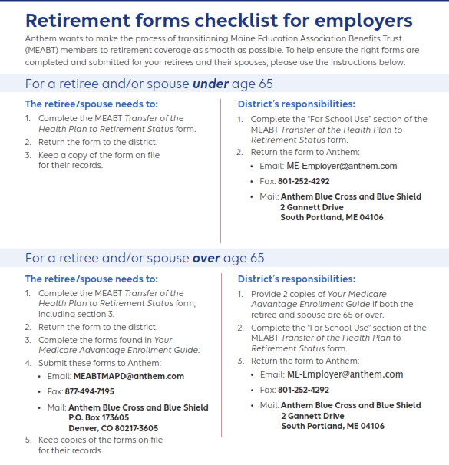
For Employer to use, not for employee.
All Transfer to Retirement Status forms should be given back to the District’s Central Office for submission to Anthem.

Slide 17
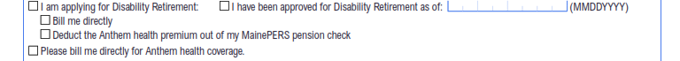
Disability
Remember, when an employee is applying for disability, they must have had 12 months of continuous active service and coverage immediately prior to their termination of employment due to disability.
1. Employee would need to maintain their insurance, or they may take the Break Provision until the disability is approved. When someone is applying for disability, on the Transfer to Retirement Status form, in section four they need to choose that they are applying for disability and choose “bill me directly”.
Once approved, they will need to complete a new Transfer to Retirement Status form to go onto the disability retirement group through MainePERS, by choosing in section four that “I have been approved for disability and the date it was approved” and choose “Deduct Anthem health premium out of my MainePERS pension”.
NO employee applying for disability would want to take COBRA unless they have no other option.

Slide 18
Retirement and Eligibility for
State of Maine’s 60% Contribution
Who is eligible to receive the State of Maine’s contribution (60%) towards the retiree’s portion
of the health insurance premium.
If they have met the basic eligibility guidelines to continue with their insurance and
If they retire through MainePERS, and
If they have a Y in their position class code. i.e., teachers =Y0101, nurses = Y2001 (Y= Yes; N= No), and
If they have reached their normal retirement age, determined by MainePERS, (i.e., the age they can collect their MainePERS pension, without any penalty for early withdrawal), this age can be 60, 62 or 65 and
If they have their health insurance premium deducted from their MainePERS pension.
The State of Maine’s 60% contribution continues for eligible employees 65 and on Medicare Advantage PPO plan (MEABT).

Slide 19
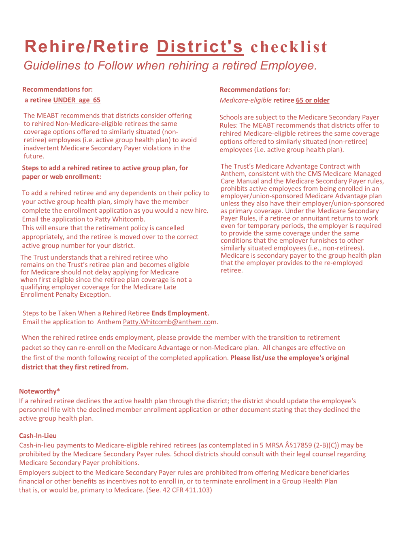
Rehiring a Retiree
If a retiree returns to work, they should be offered the district’s active health insurance, to avoid any Medicare Secondary Payor penalties to the district.
If a rehired retiree declines the active health plan through the district, the district should update the employee’s personnel file with the declined member enrollment application or other document stating that they declined the active group health plan.
If you enroll a rehired retiree, please contact Anthem at ME-Employer@Anthem.com to stop their pension deduction.
Cash in lieu guidelines are on the checklist.

Slide 20
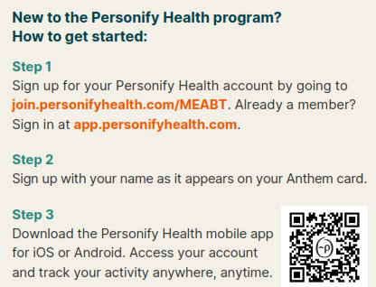


Personify Health Wellness
Our wellbeing program is designed to help you build healthy habits, manage stress, stay active and make the healthy changes you want to see. By staying engaged with the program over time, you’ll earn points toward $62.50 each quarter to total $250 a year. Plus, reach Level 2 or higher and be entered into a quarterly drawing for a chance at winning one of two $250 in rewards! As an added bonus, once you reach Level 4, a new Secret Level 5 will be unlocked. Those who complete Level 5 will be entered into a drawing for $50 in rewards.
Eligibility -Everyone enrolled (active & retired) in an MEABT health plan, including enrolled spouses, domestic partners, and dependents aged 18–26, are invited to sign up. Once you’re signed up, be sure to invite your coworkers to join in on the fun!
Questions - Contact Personify Health Member
Services: 855-689-6884.

Slide 21
Wellness Ambassador Role
MEABT Wellness Ambassadors inspire, excite and encourage others to join and participate in our wellness program with Personify Health.
Ambassadors are the local experts and the driving force for increased participation and improved health of the MEABT community.
Responsibilities –
  Promote all wellness programs offered through the MEABT and know where to find the most up-to-date information.
  Engage, work with Michael Booth to set-up location-specific challenges.
  Share wellness resources with staff like the quarterly newsletter, emails, flyers and posters.
  Have fun, you are the wellness advocate for your district, lead by example and have fun.
  Upon completion of the Wellness Ambassador training, held every Fall, you earn $500
  for your district to use on wellness.
Contact Information
Michael Booth, Wellness Director
mbooth@meabt.org

Slide 22
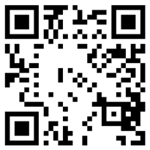
Scan this QR code with your phone’s camera, to download and log into Sydney Health.
SYDNEY HEALTH APP
What to expect from Sydney Health
Convenient Experience – Quickly find information, Member Services, LiveHealth Online video doctor visits, wellness resources and an interactive chat feature.
My Health Dashboard – This dashboard is a hub for personalized health and wellness.
Find Care – Use this tool to find a provider who is in the plan’s network. Results are matched with members unique needs, preferences and plan details.
Virtual Care Options – Chat with a doctor or have a video visit at a convenient time and place at no additional cost. The app also offers comprehensive primary care, annual preventive wellness visits and lab screenings, 24/7 urgent care, and unlimited access to care for common health concerns like flu or allergies, as well as prescription referrals and refills.

Slide 23




Take Control of your Mental Health

Slide 24
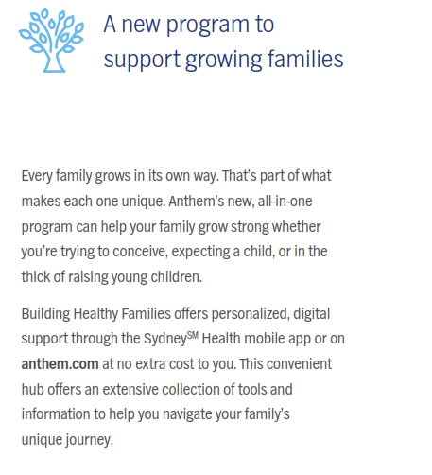
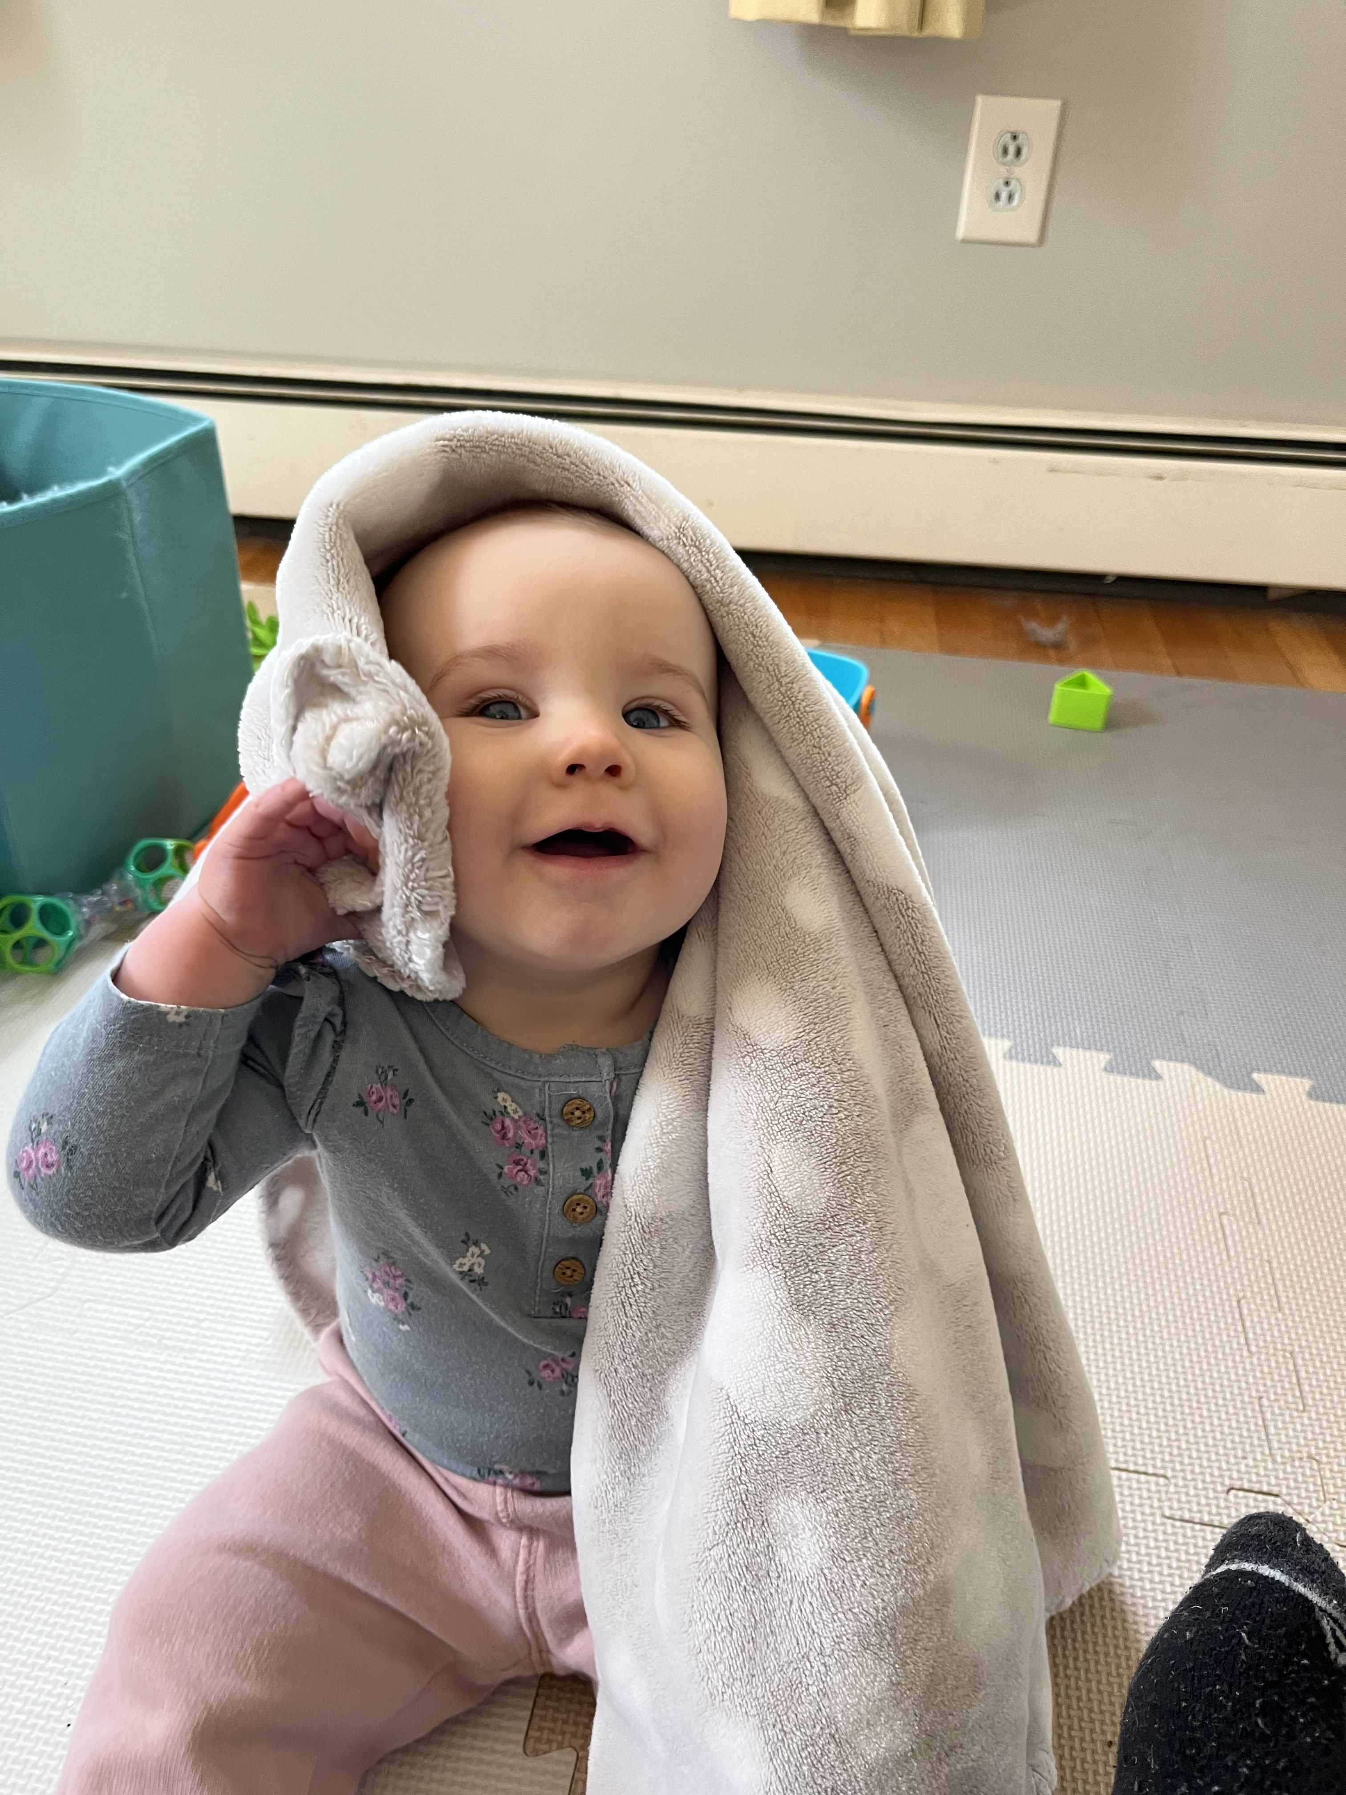
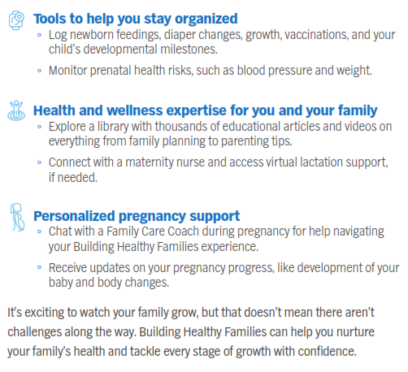

Building Healthy Families
Enroll today
Visit anthem.com or log in to Sydney Health.
Find Featured Programs at the bottom of the homepage.
Select View All then choose the Building Healthy Families tile.
You can also scan this QR code.

Slide 25
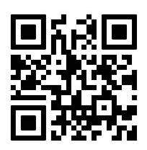

Additional Benefits
Lark
Lark is a personal diabetes prevention coaching program that can help you determine if you’re at risk for
prediabetes and, if needed, take steps to address it. To see if you could benefit from this no-extra-cost program,
go to lark.com/anthem or scan the QR code with your phone’s camera and take a quick survey.
You can also access Lark using the Sydney SM Health app under Programs in My Health Dashboard.
Upon qualified registration, participants will receive a wireless scale. As participants progress through four
milestones, they’ll improve their health, reduce diabetes risk, and could earn a fitness tracker and 5,000 Personify Health points.
ConditionCare
ConditionCare is an Anthem program to help you understand and manage long-term conditions:
Asthma Congestive heart failure Chronic obstructive pulmonary disease( COPD)
Coronary artery disease Diabetes
Call 1-866-962-0960 to sign up.
Lin Health
A new clinically-proven treatment is now covered for Anthem members in Maine, available by telehealth. Lin Health Medical Group is a specialty medical practice offering a new clinically-proven treatment for chronic pain.
Try Lin Health’s new pain recovery care today. Call (207)405-0901 Visit www.lin.health/anthem-me

Slide 26
Programs Available to All Employees
with or without health insurance
*Member Assistance Program (MAP) EMPLOYEES and their household
The MAP is a no-cost and confidential program to help deal with a wide range of personal or work problems, even if you and your household members aren’t on the health plan, this is available to you.
From relationships, parenting and family concerns, to emotional issues like stress, anxiety, depression and grief, — even substance abuse and financial and legal matters. Call the MAP 24/7 to set up visits with licensed therapists, attorneys, financial advisors and other professionals. Just contact the MEA Benefits Trust MAP through Anthem Blue Cross and Blue Shield in Maine.
1-855-686-5615
anthemEAP.com
Password for all: MEABT
*LiveHealth Online
Have a video visit with a board-certified doctor, psychologist or psychiatrist from your smartphone, tablet or computer with a webcam. This is a great option when you can’t get to a doctor or clinic.
Doctors can treat rashes, infections, colds, the flu and more. Doctor can send in a prescription to your pharmacy, if needed.
Psychologists and therapist can provide therapy while a psychiatrist can prescribe medicines, if you need.
Dermatology visits are now included as are Lactation consultations.
Pre-register at livehealthonline.com Or call LiveHealth Online at 1-844-784-8409
Remember these now have no copay for members on the health insurance policy. Nonmember's cost is $59.

Slide 27
MAP CRITICAL INCIDENT RESPONSE
Employer
If a traumatic event happens at your district/school, it can affect employees’ sense of safety and well-being. The MAP offers critical incident response (CIR) services to help you reach out to employees. You can have MAP counselors for CIR consultations. This service may be available at no cost to you or your district if MEABT has banked hours available to cover your request (Cost is typically $300/hr.).
Contact Lynn Aceto or any staff member at MEABT, laceto@meabt.org or 1-207-622-4418 ext. 2507
Training sessions are available for the districts. Monthly webinars are also available for your employees.
Information on the training sessions and monthly webinars is found on our website at www.meabt.org, under RESOURCES, MAP.

Slide 28
Additional Benefits Phone Numbers
ConditionCare .......................................................866-962-0960
Healthy Families....................................................866-347-8360
24/7 NurseLine .....................................................800-337-4770
*Member Assistance Program .....................……..855-686-5615
MAP CRITICAL INCIDENTS…………………………………207-622-4418 ext. 2507
Personify Health....................................................855-689-6884
MEA Benefits Trust ...............................................888-622-4418
LIN Health…………………………………………………………207-405-0901
*LiveHealth Online ...............................................livehealthonline.com
Lark Diabetes Prevention Program……………………Sydney Health App.
* Available to all employees, regardless if they are on our health insurance or not, and available to anyone who resides in their household.

Slide 29
Contact Page
Jennifer Kent, Executive Director
  jkent@meabt.org (207) 622-4418 ext. 2238
Sharon Beaulieu, Benefits Manager
  sbeaulieu@meabt.org (207) 622-4418 ext. 2207
Lynn Aceto, Field Account Manager
  laceto@meabt.org (207) 622-4418 ext. 2507
Michael Booth, Wellness Director
  mbooth@meabt.org (207) 622-4418 ext. 2510
Patty Whitcomb, Anthem BC/BS, Account Specialist
  patty.Whitcomb@anthem.com (207) 822-7556

